Slide 1


Data Provider/.JSON/Excel/Database
Prepared By-Shrish Tripathi

Slide 2
Data Provider

Slide 3
What is data provider?
Write once test many times
When it comes to automation, data provider is an approach to pass test data to the automation tests. Each and every automation tool has it’s own way of providing test data to the automation

Slide 4
Which data provider we need to use for protractor?
For Jasmine framework – jasmine-data-provider npm package

Slide 5
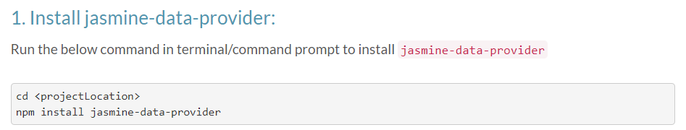

Slide 6
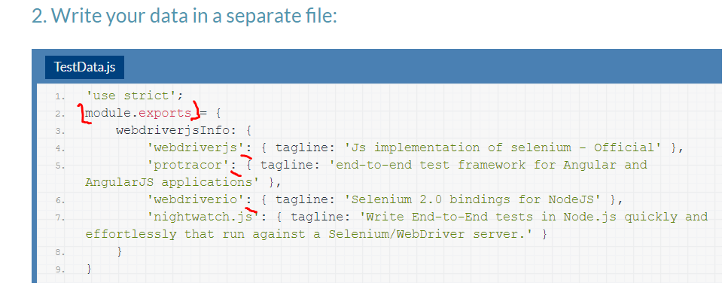

Slide 7
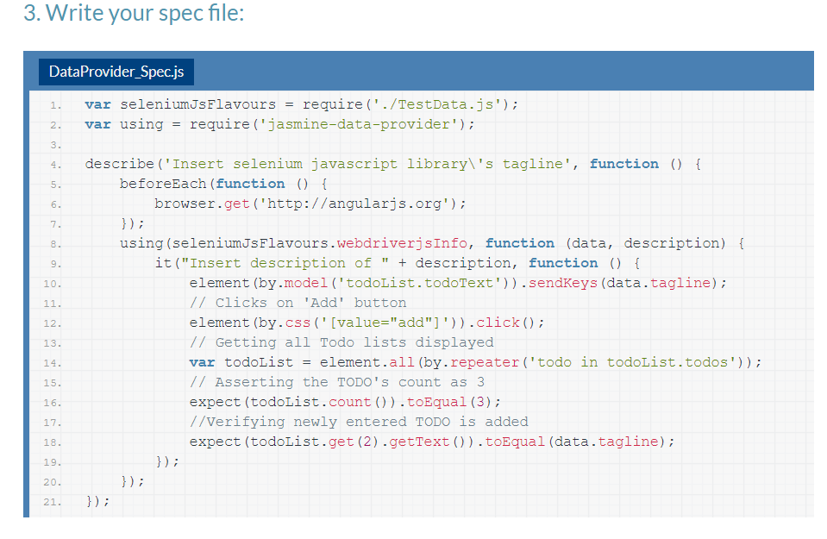
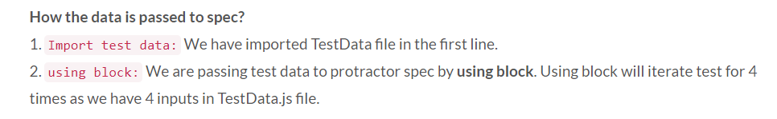

Slide 8
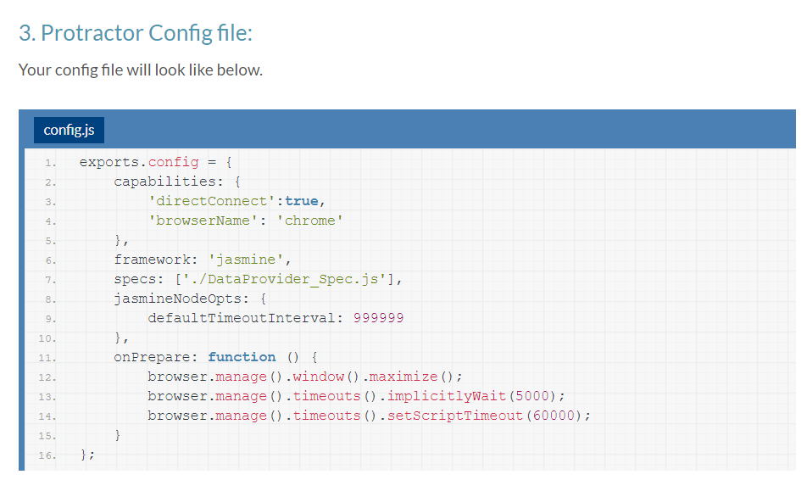

Slide 9
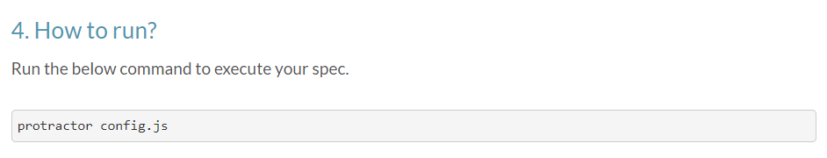

Slide 10
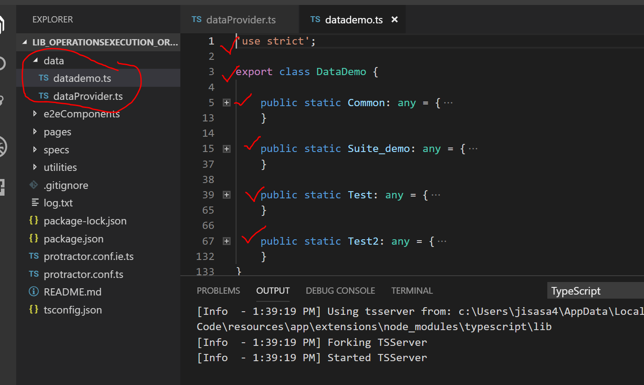
Real Time Example

Slide 11
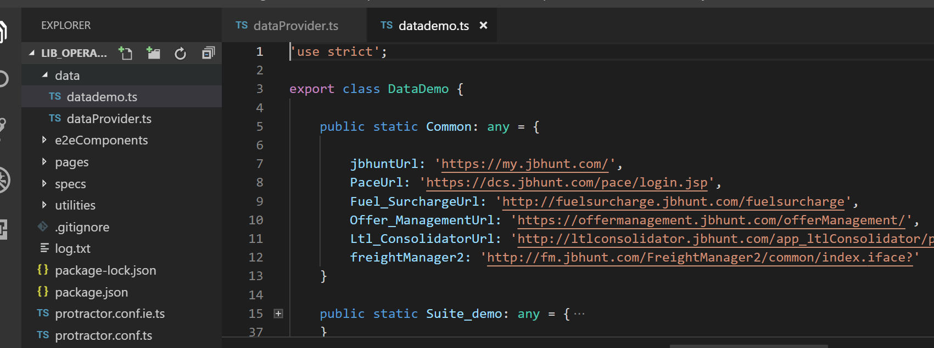

Slide 12
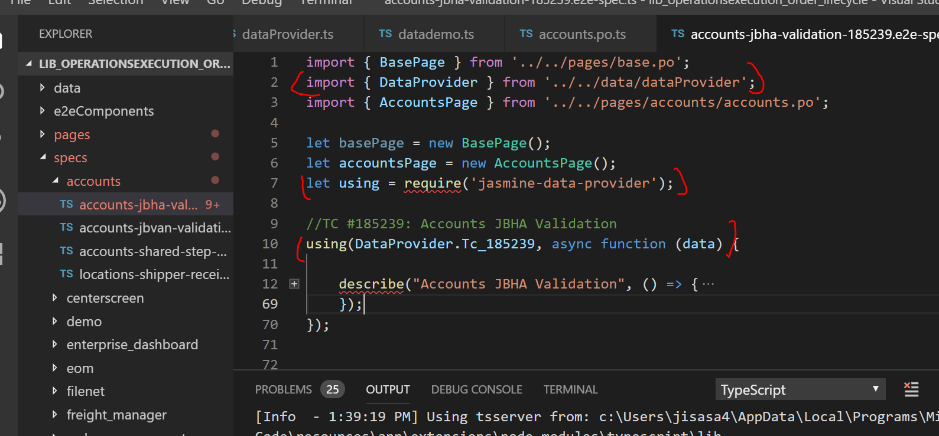

Slide 13
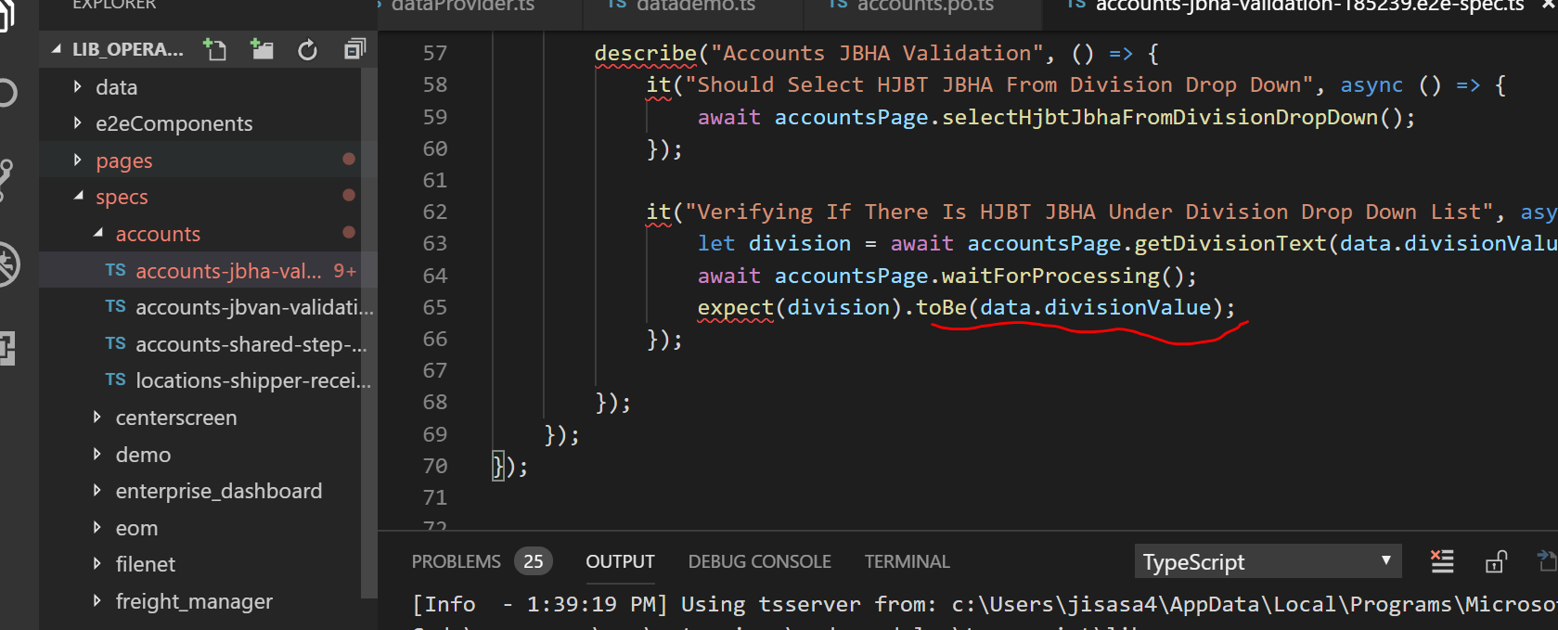

Slide 14
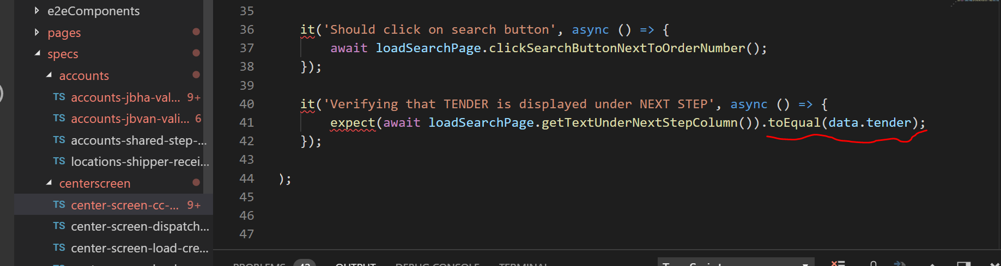

Slide 15
.JSON

Slide 16
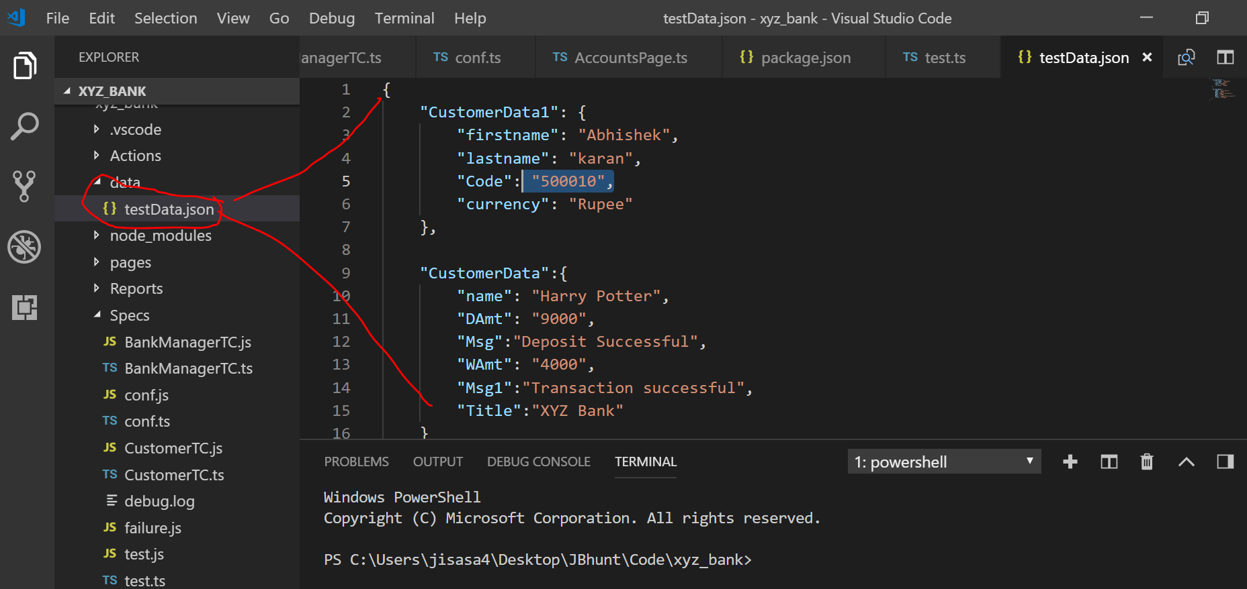
Add .Json test data file:

Slide 17
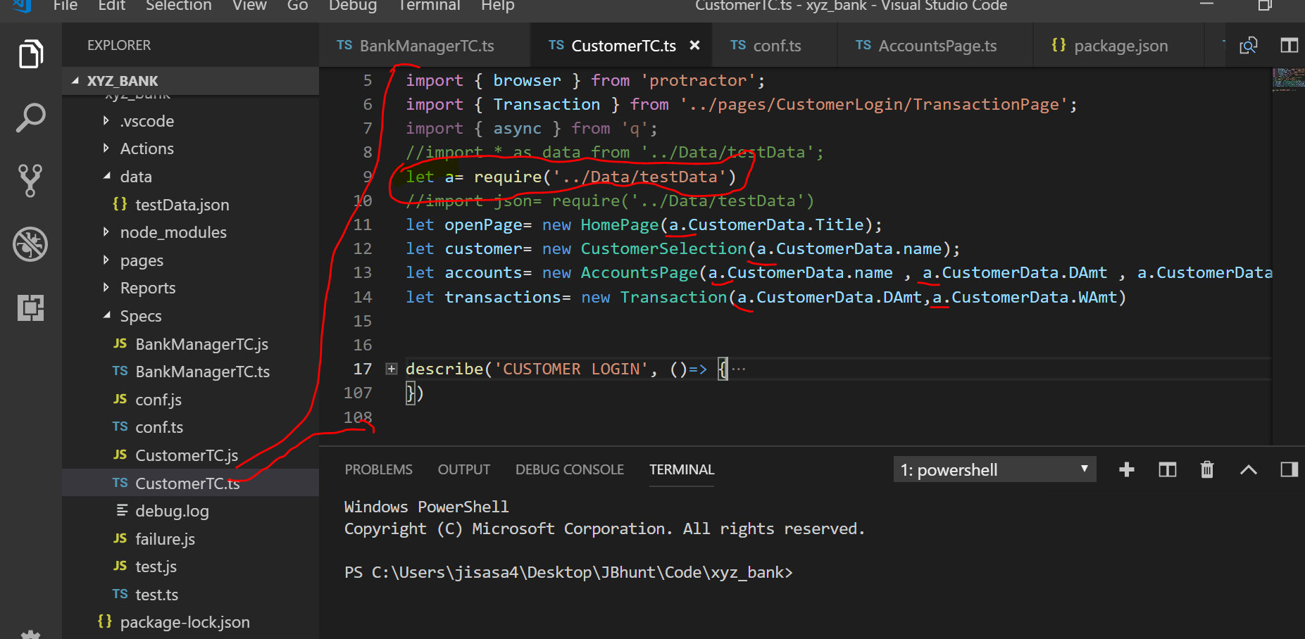

Slide 18
Excel

Slide 19

Get the excel package

Slide 20
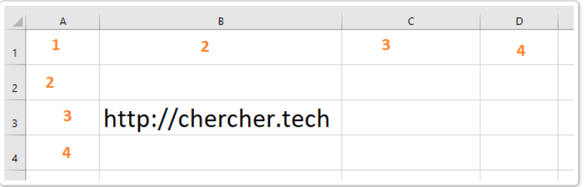

Slide 21
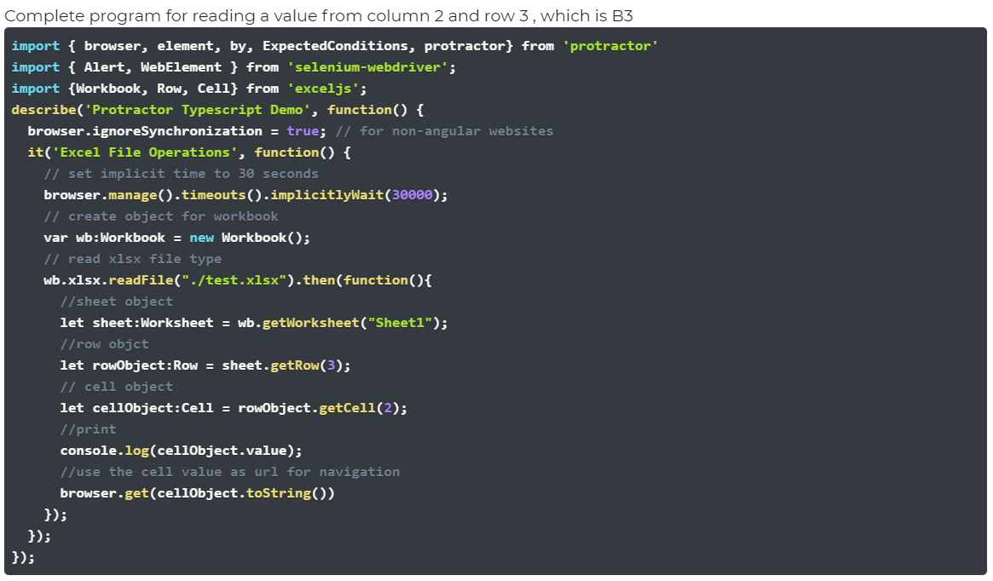

Slide 22

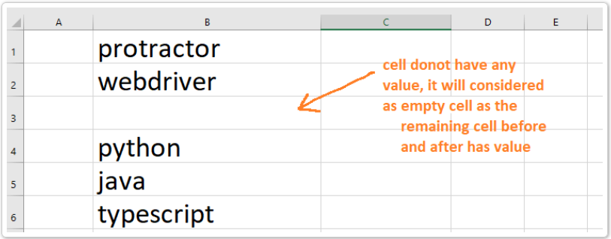

Slide 23

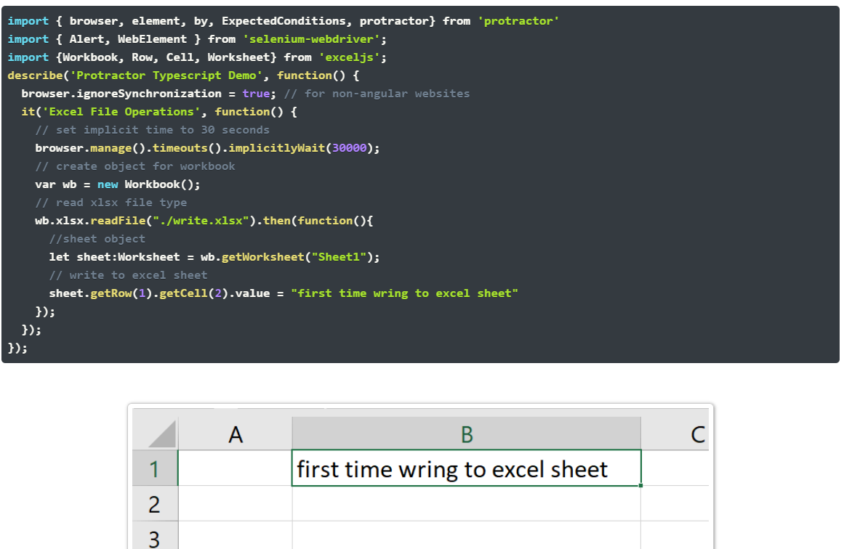

Slide 24



Slide 25
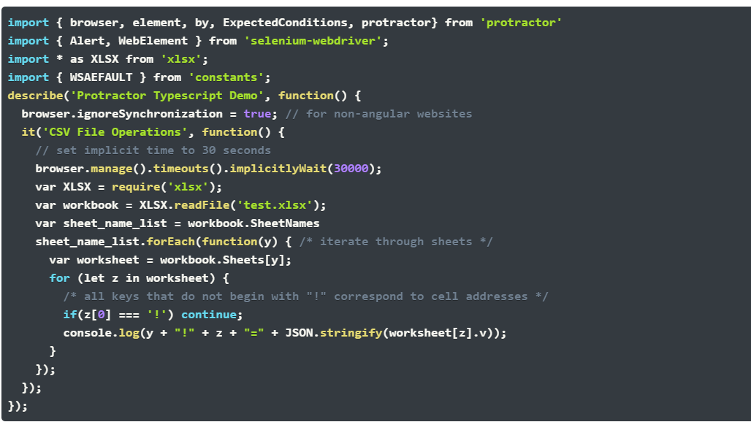

Slide 27
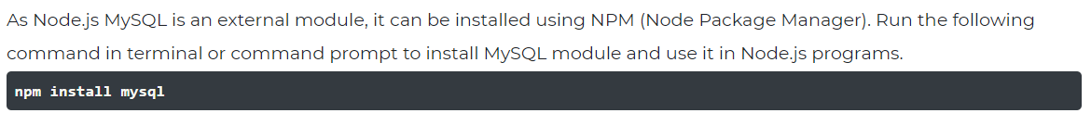

Slide 28
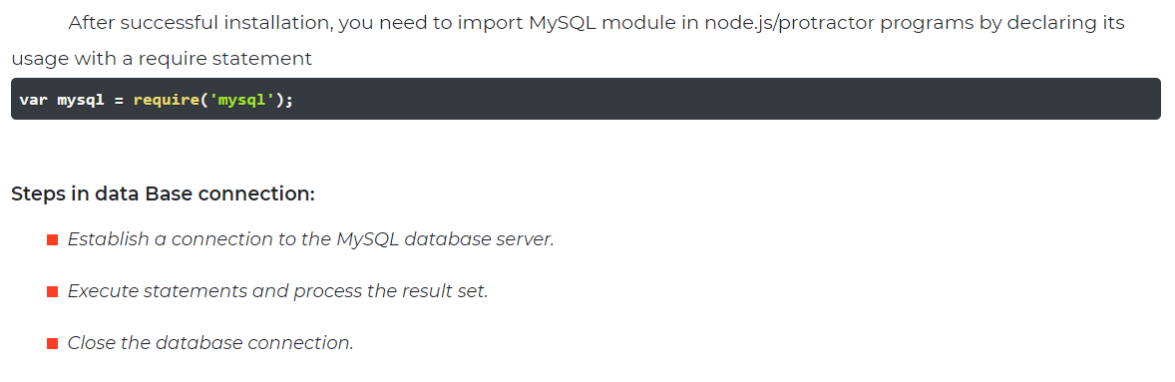

Slide 29
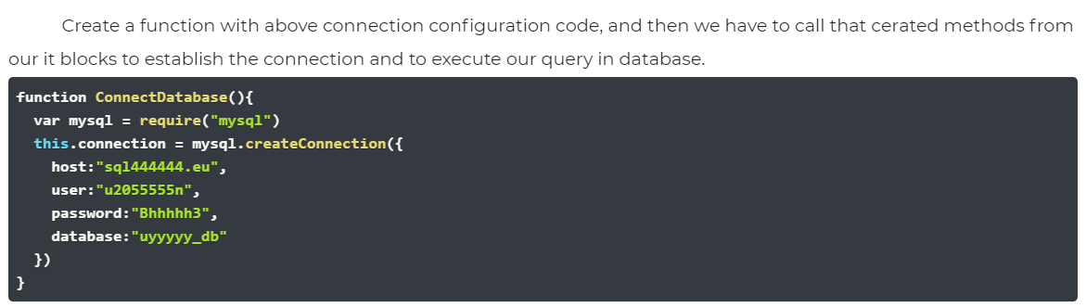

Slide 30
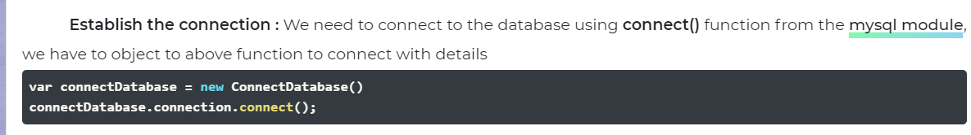

Slide 31
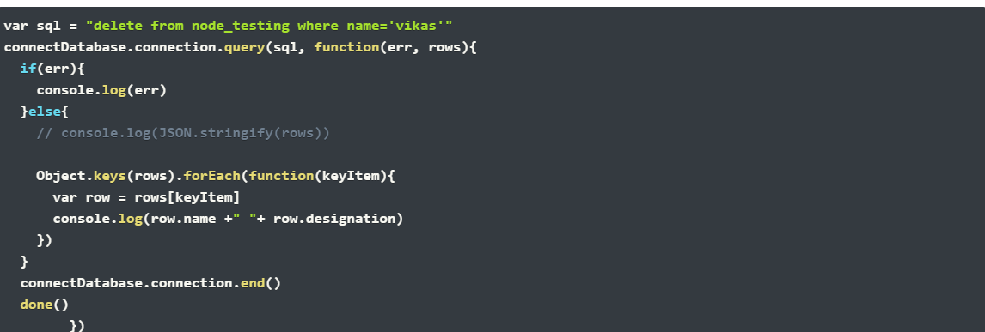

Slide 32
